Slide 1
INTRODUCTION TO MODULAR SYNTHESIS
Signal Flux x Pioneer Works
September 2019
Week 4: The Real World

Slide 2
Agenda
Review
Deeper into VCV Rack
Recording
MIDI Controller
VST Plugins
Installing Plugin Libraries
Connecting to a DAW
Hardware Interfacing
MIDI
Audio
Envelope Following
CV Tools/Silent Way
Hardware
Organizing/Planning a Case
Compositional Goals/Paradigms
Connectivity/Interfacing
ModularGrid
Semi-Modular
Other Possibilities
Max/MSP
DAWs

Slide 3
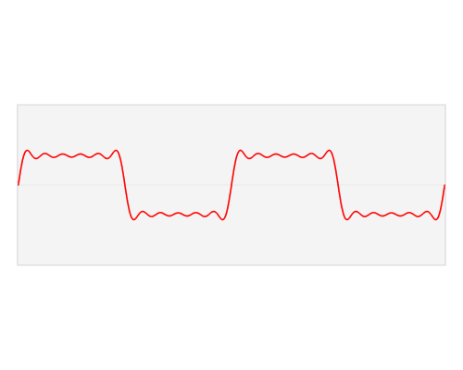
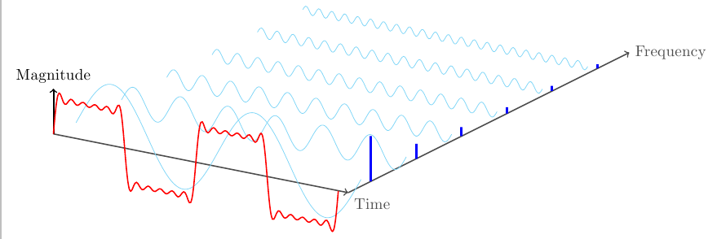
Fourier Series
The waveshape of an oscillator determines its timbre.
Any periodic waveform (i.e. a repeating oscillation) can be created by mixing sine waves whose frequencies are all multiples of the original periodic waveform’s frequency. By carefully controlling the amplitude of each of the sine waves, any other waveform can be created.
The original frequency of the waveform is known as the fundamental frequency. The integer multiples of the fundamental are known as harmonics.
Sounds which are more complex than an oscillation, like a percussive hit or spoken language, may include many more sine waves that are not harmonic multiples of a fundamental frequency. These are known as partials.
Demo

Slide 4
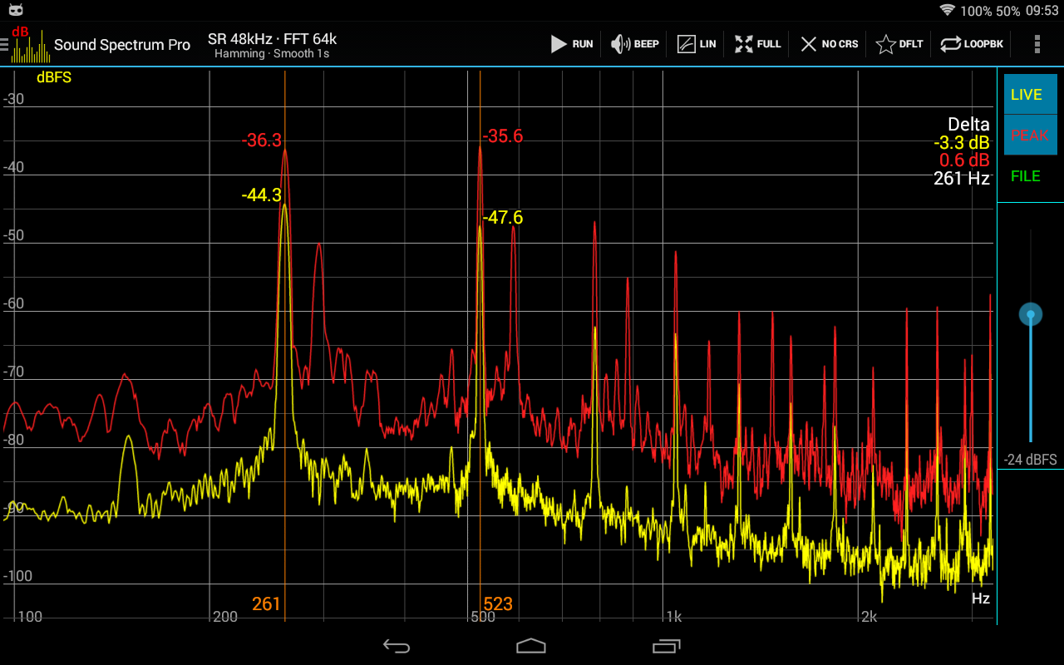
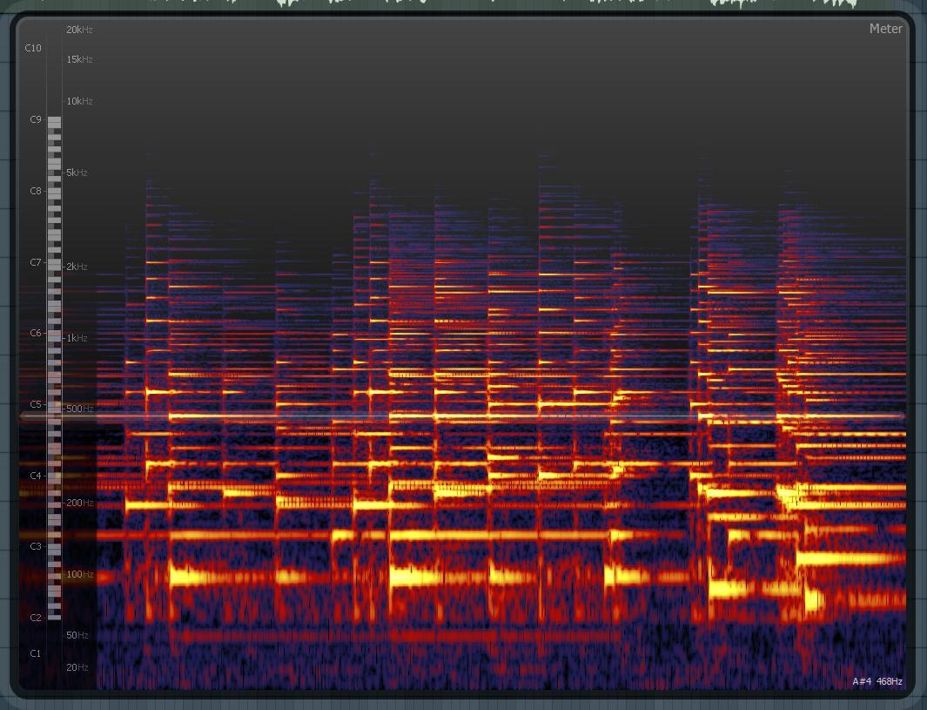
Spectrum
The frequency domain is used to understand the harmonic content of a sound: the x-axis is frequency, while the y-axis measures the amount of energy at each frequency.
A sound’s spectrum is its representation in the frequency domain: it shows the energy at all the individual frequencies that make up a sound.
A spectrogram uses three dimensions to show how a sound’s spectrum changes over time. The x-axis is time, the y-axis is frequency, and the z-axis is energy.

Slide 5
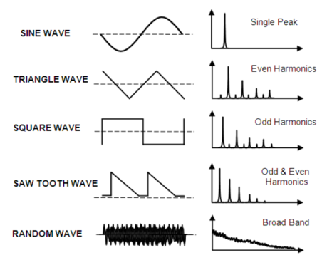
Waveshape
The time domain visualizes a changing voltage: the x-axis is time, while the y-axis is voltage. The waveshape of a signal is a graph of its changing voltage as a function of time.
Sine waves are the simplest of all wave shapes, containing only a single fundamental frequency and no additional harmonics.
Square waves contain additional odd harmonic context.
Triangle waves contain a fundamental sound plus odd harmonics.
Square waves contain both odd and even harmonics.
Noise is made up of energy at every frequency.

Slide 6
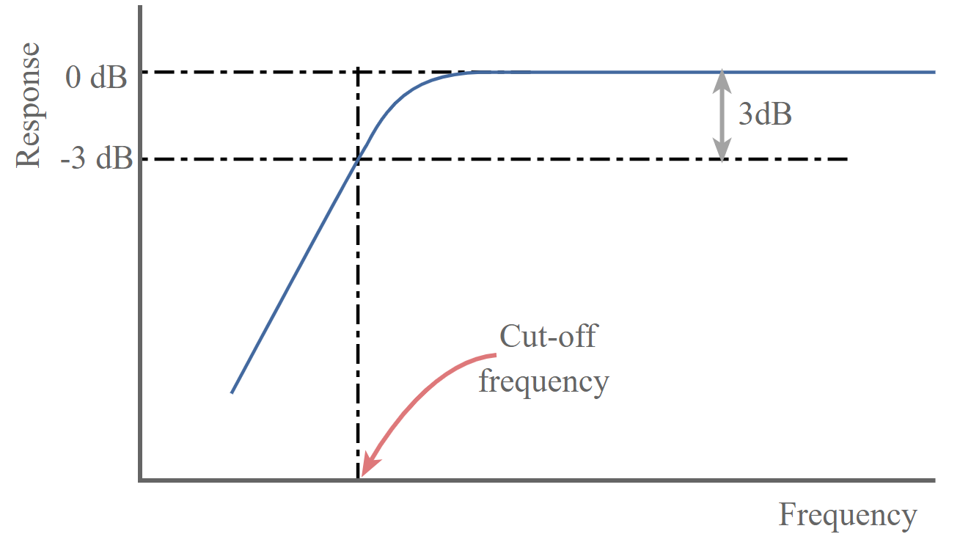
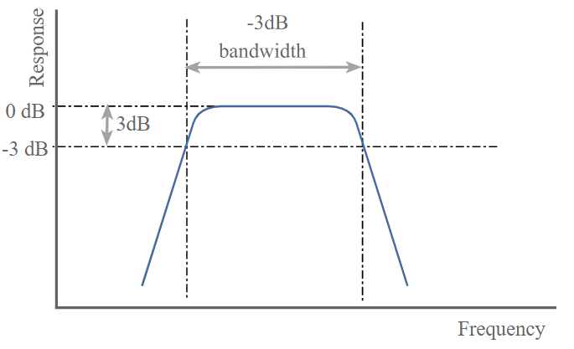
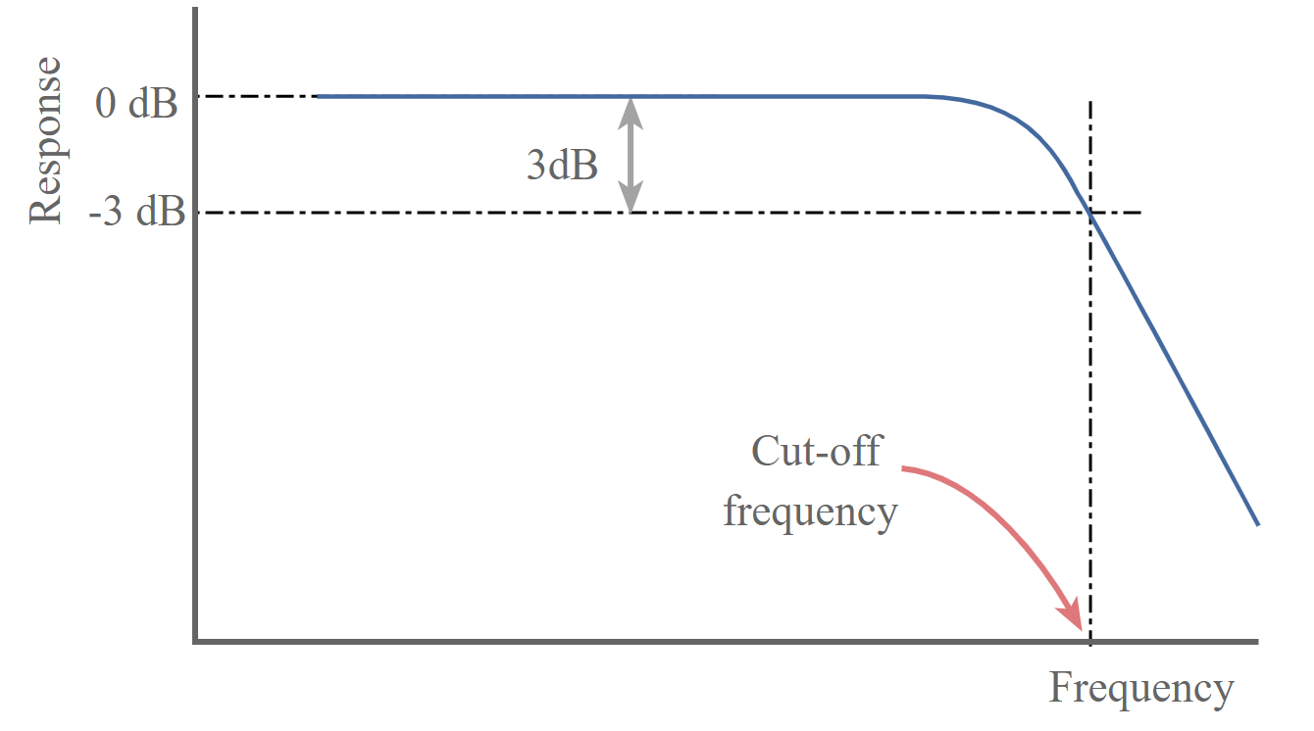
Filters
Subtractive synthesis adjusts the timbre of a sound by removing harmonic content.
A filter attenuates frequencies above or below a specific threshold or cutoff frequency.
A lowpass filter passes all of the harmonics below its cutoff and reduces the level of higher harmonics above that cutoff.
A highpass filter passes all harmonics above its cutoff and attenuates the lower harmonics below the cutoff.
A bandpass filter allows harmonics around the cutoff to pass through and reduces frequencies that are above and below the cutoff.
The strength of filter is determined by its slope: the lower the slope, the less aggressively it attenuates filters below or above its cut off.

Slide 7
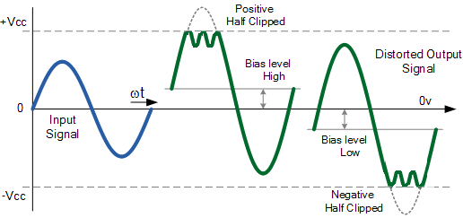
Wavefolding
Wavefolding is a type of wave shaping where signal peaks above a threshold are inverted in a series of folds, resulting in new harmonics being added.

Slide 8
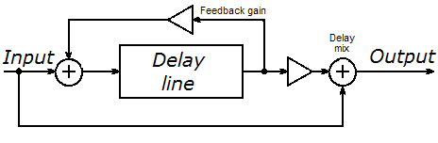
Delay
Delay is a time-based audio effect that mimics echos. An “echo” occurs when a sound is repeated multiple times after it first occurs, usually at a decreasing volume each time.
A delay line works by receiving a signal, holding it for some amount of time (the delay time) before sending it to the output.
The delayed signal is also sent back to the input at a lower volume, resulting in the sound being delayed a second time but at a lower volume. The number of repeats or echos is determined by the feedback gain.
Effects (including delays) often have a dry/wet mix, which allows the user to control the amount of the original “dry” signal heard and the amount of the processed “wet” signal heard.

Slide 9
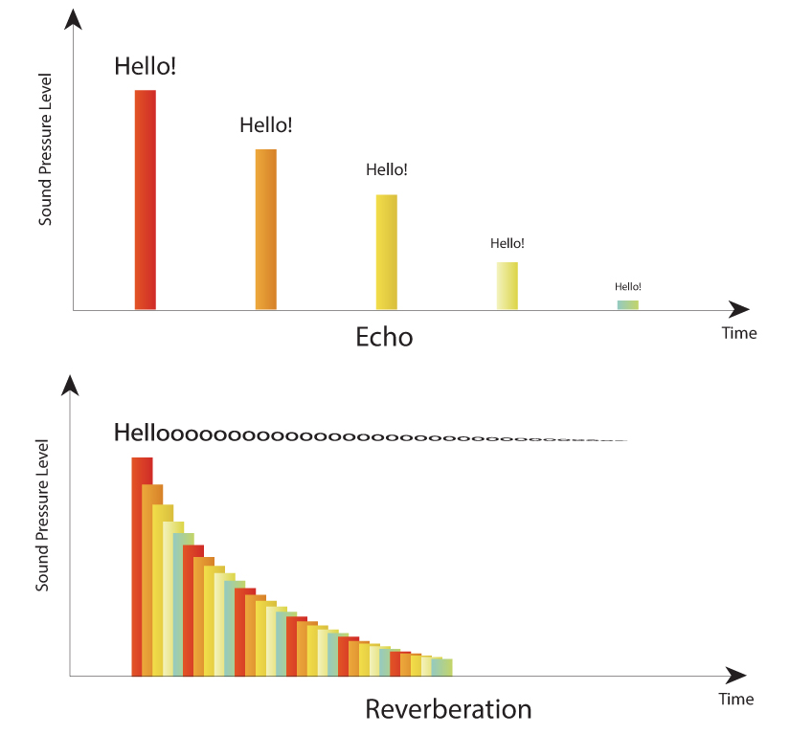
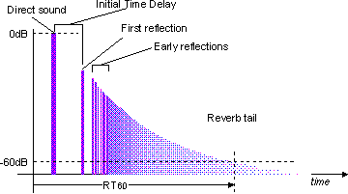
Reverb
Reverb naturally occurs when a sound hits many surfaces and reflects back to the listener. Each reflection takes a slightly different amount of time to reach the listener. Each reflection will also have a slightly different amplitude and filtered waveshape depending on the material it reflected off of. Together, these clouds of reflections create the reverberant ambience of a space; they sound like a smeared, diffused echoing tail of the original sound.
Reverb can also be applied artificially to a sound to give it a sense of space.
Pre-Delay controls the amount of time it takes for the first reflection to reach the listener.
Decay Time controls the amount of time it takes for the reflections to entirely fade out.
Dry/Wet controls the balance between the original sound and the effected sound.

Slide 10
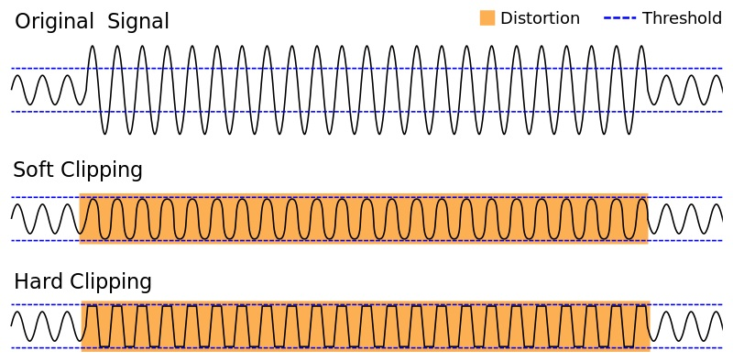
Distortion
A gain effect achieved by overloading the input. The result is usually a compressed, gritty tone.

Slide 11
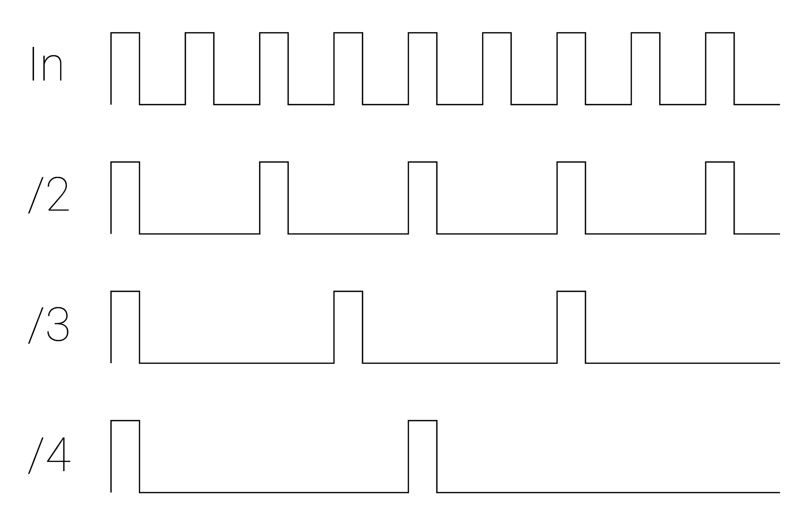
Clock Modulation
Demo
Clock modulation converts a steady streams of gates/triggers, aka a clock, into a new pattern or "rhythm" of pulses which is somehow synchronized to the original clock.
Clock Dividers: output 1 pulse for n input pulses
Clock Multipliers: output n pulses for every 1 input pulse

Slide 12
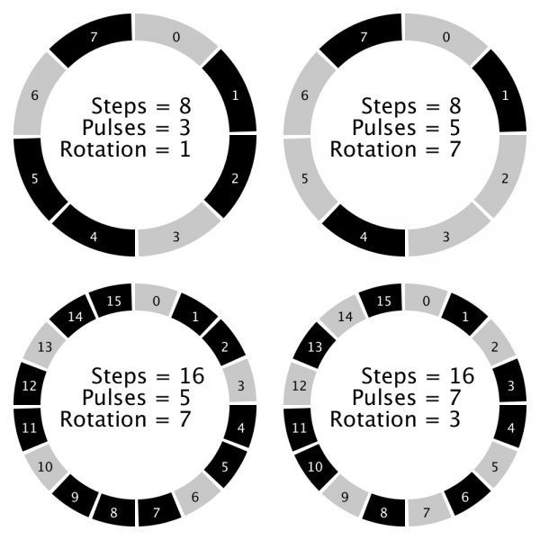
Euclidean Rhythms
Demo
Euclidean rhythms are a unique form of clock modulation generated by distributing a determined number of pulses as evenly as possible across a determined number of steps.
Euclidean Length: The number of steps in the pattern
Euclidean Fill/Trigs: The number of pulses in the pattern.
Euclidean Rotation: Determines where the first hit in the pattern occurs (shifts the pattern forward/backward in time)
Combinations of Euclidean rhythms are core elements of many musical traditions from all over the world.
Demo

Slide 13
Phasing LFOs and Polyrhythms
Polyrhythms generate complex patterns by combining one or more different sets of rhythms played against each other which do not subdivide into each other evenly, e.g. a pattern with a length of 4 steps and a pattern with a length of 7 steps.
Similarly, LFOs with unequal frequencies can creating evolving relationships between parameters.

Slide 14
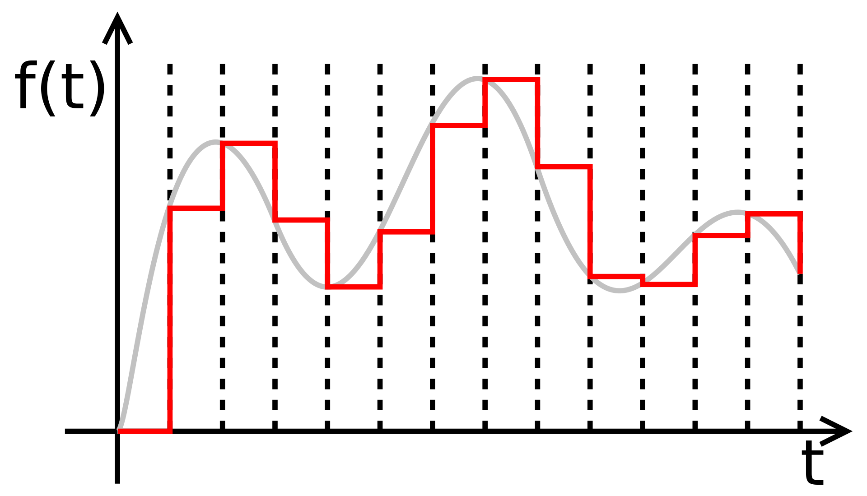
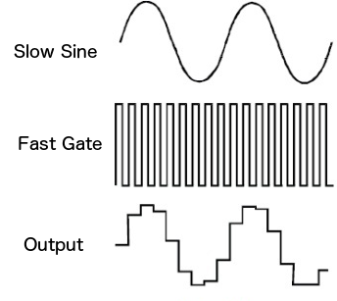
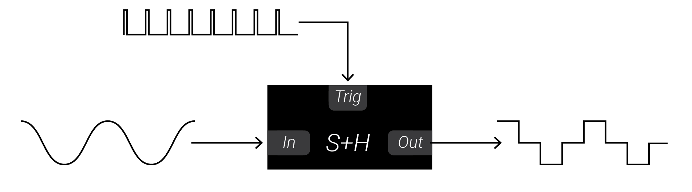
Sample + Hold
Sample+Hold modules expect two inputs: a voltage to sample and a trigger.
When a trigger arrives, the main voltage is checked, frozen instantaneously and sent to the output.The output voltage does not change until another trigger occurs.
S+H modules allow you to turn any signal into a stepped sequence of voltages.
Pairing a S+H with two phasing LFOs is a great way to generate evolving sequences.
S+H can even be used as sample-rate reduction distortion when used with an audio signal and fast clock!

Slide 15
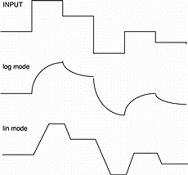
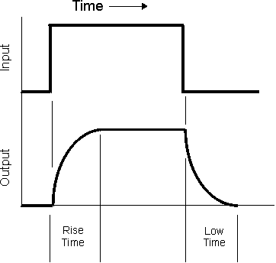
Slew Limiters
Slew limiters smooth out changes in a voltage. The output voltage is like a “laggy” version of the input voltage: it takes time to catch up (slew) to the input.
A slew limiter has two main parameters: the rise-time and fall-time.
When the input voltage increases, the output voltage rises to the new voltage in the amount of time specified by rise.
When the input voltage decreases, the output voltage falls to the new voltage in the amount of time specified by fall.
SLs can be used to smooth out random sequences, create glissando/slides, and much more!
SLs can even be used as lowpass filters since removing sharp transitions = rounding edges = removing HF content.

Slide 16
Deeper into VCV Rack
Recording
MIDI Controller
VST Plugins
Installing Plugin Library
Connecting to a DAW

Slide 17
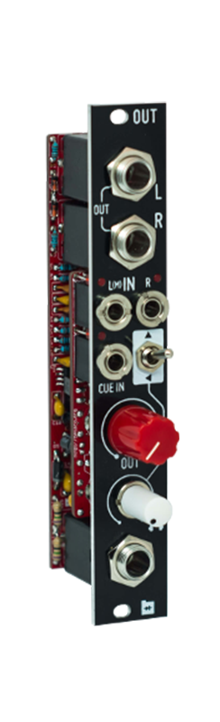
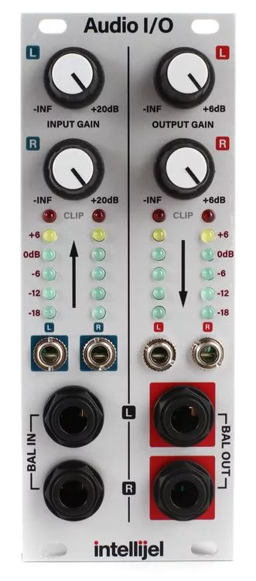
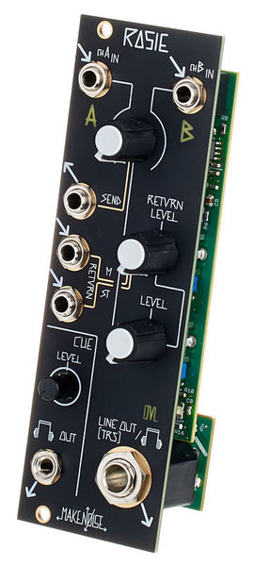
Hardware Interfacing: I/O
Input/Output (I/O) Modules let you perform two main tasks: they change the volume of signals to take them from modular levels (SUPER loud) to “line level” - the right volume for headphones, speakers, etc. and vice-versa.
Output modules take in modular signals and generate line level signals, while input modules do the reverse. Some modules provide both functions!

Slide 18
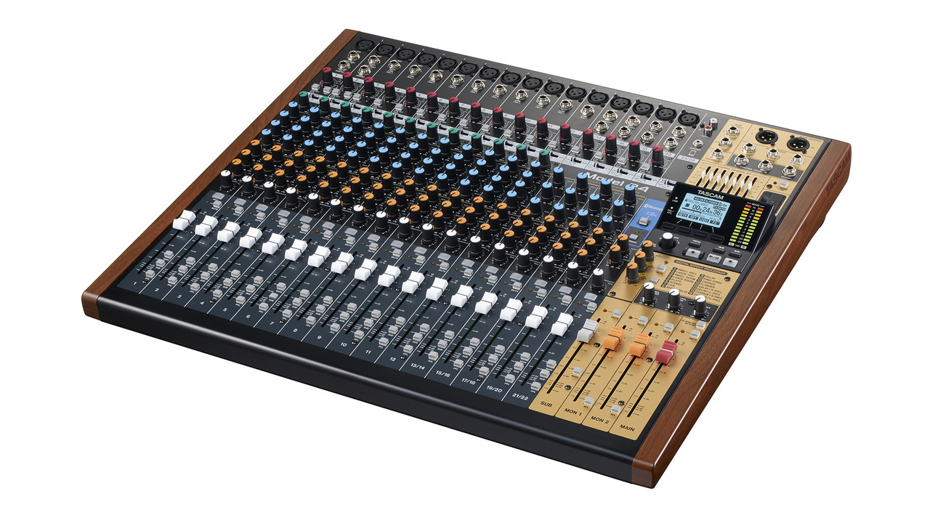
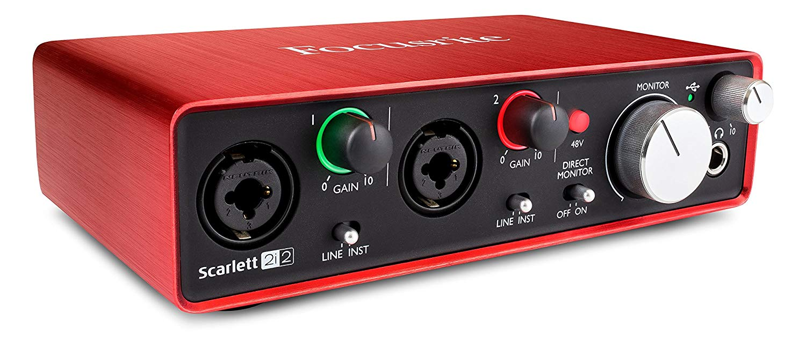
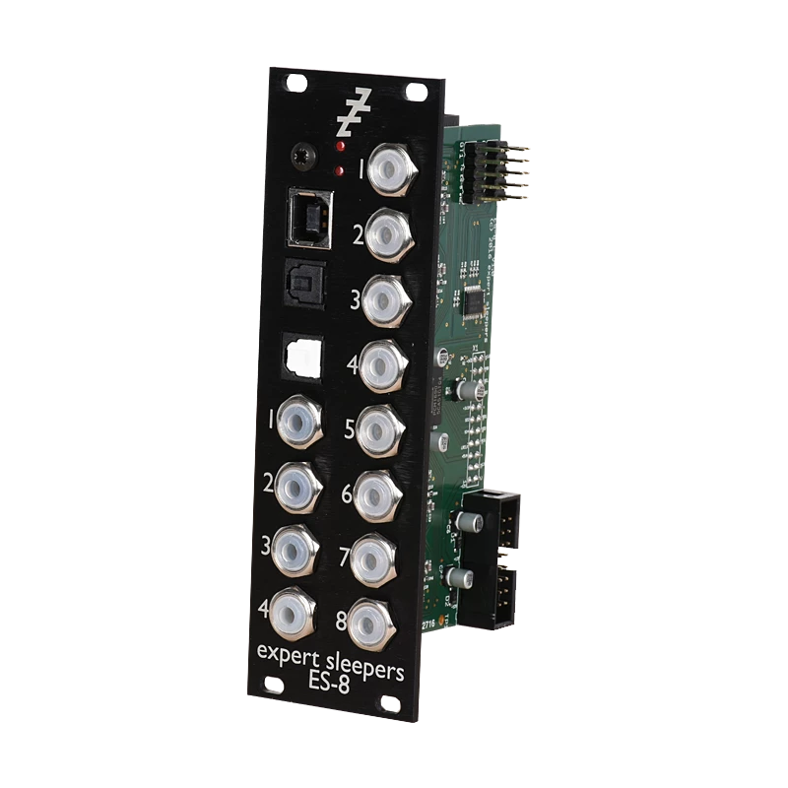
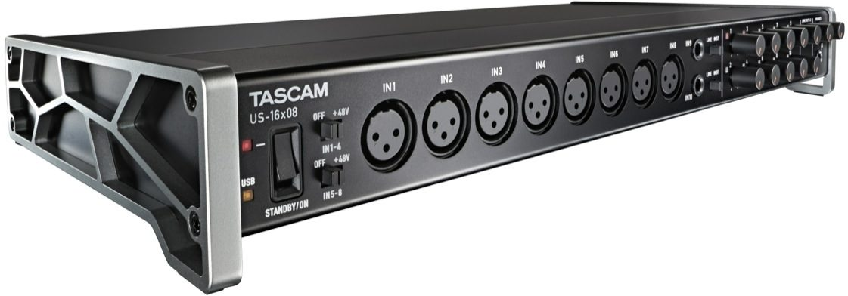
Hardware Interfacing: Audio Interfaces
Audio Interfaces allow you to do two main tasks:
ADC: Send analog signals into a computer for recording (analog-to-digital conversion)
DAC: Send digital signals out from the computer to speakers or into your modular synthesizer (digital-to-analog conversion)
Some interfaces may be combinations of mixers and interfaces, allowing you to both control the audio levels and digitize signals for the computer.
There are even USB interface modules!

Slide 19
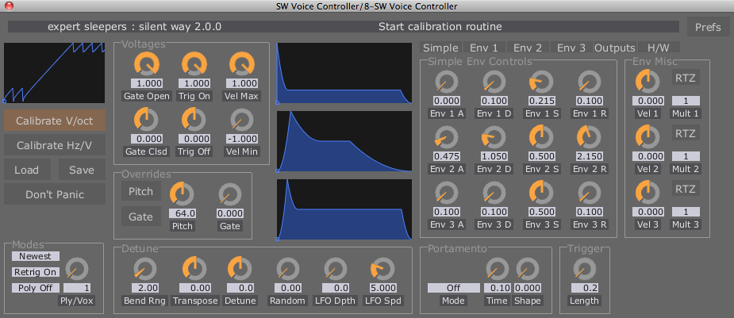
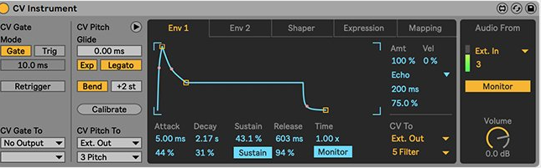
Hardware Interfacing: DC-Coupled Tools
DC-coupled interfaces can also receive and send out control voltage, allowing you to send and receive clock information, CV sequences, note data, gates, LFOs etc. between your synthesizer and computer.
Expert Sleeper’s Silent Way and Ableton’s CV Tools pack are two useful ways of generating this data.
Bitwig, a digital audio workstation (DAW) is also extremely flexible at generating CV signals for DC-Coupled interfaces!
Max/MSP is also another wonderful choice!
Your modular can also be used to control parameters in you DAW environment with a DC-coupled interface!

Slide 20
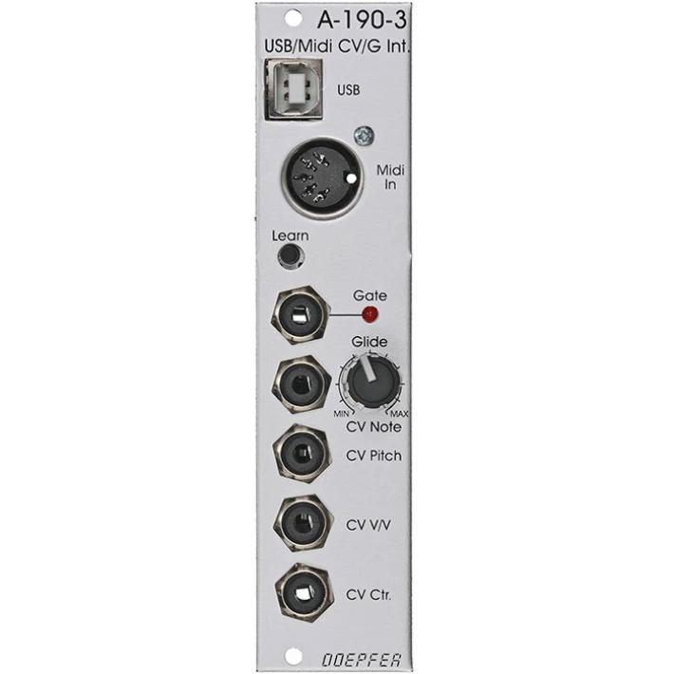
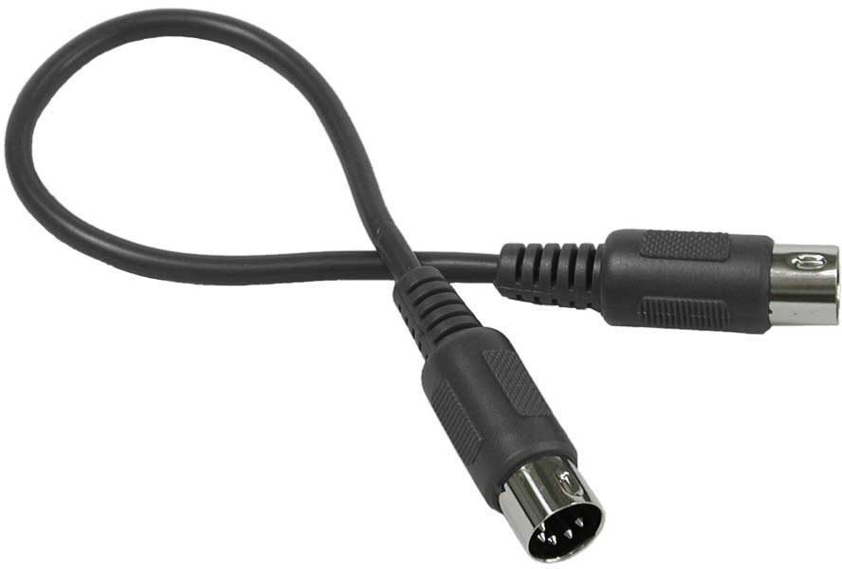
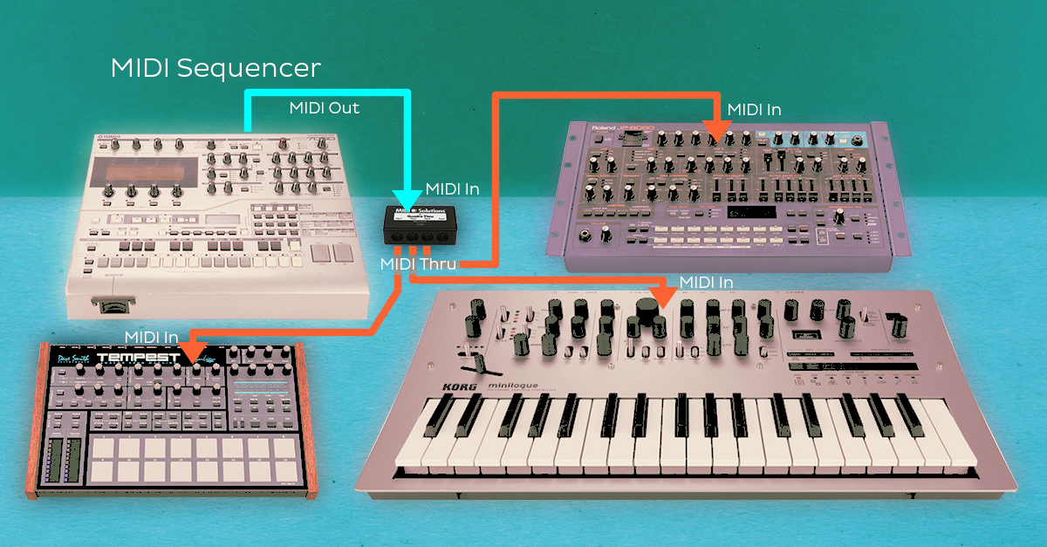
Hardware Interfacing: MIDI
MIDI, or the Musical Instrument Digital Interface, is a “protocol” (aka “communication language”) for electronic instruments to send information - clocks, note data, gates etc. - between each other.
MIDI can be used to sync devices together so that clocks run at the same rate, or to use a keyboard to control note data for another device, and more!
MIDI-to-CV modules receive MIDI data from another device and create CV for use in the modular system.
CV-to-MIDI modules are used to convert control data from a modular synthesizer into digital information for controlling a destination device.

Slide 21
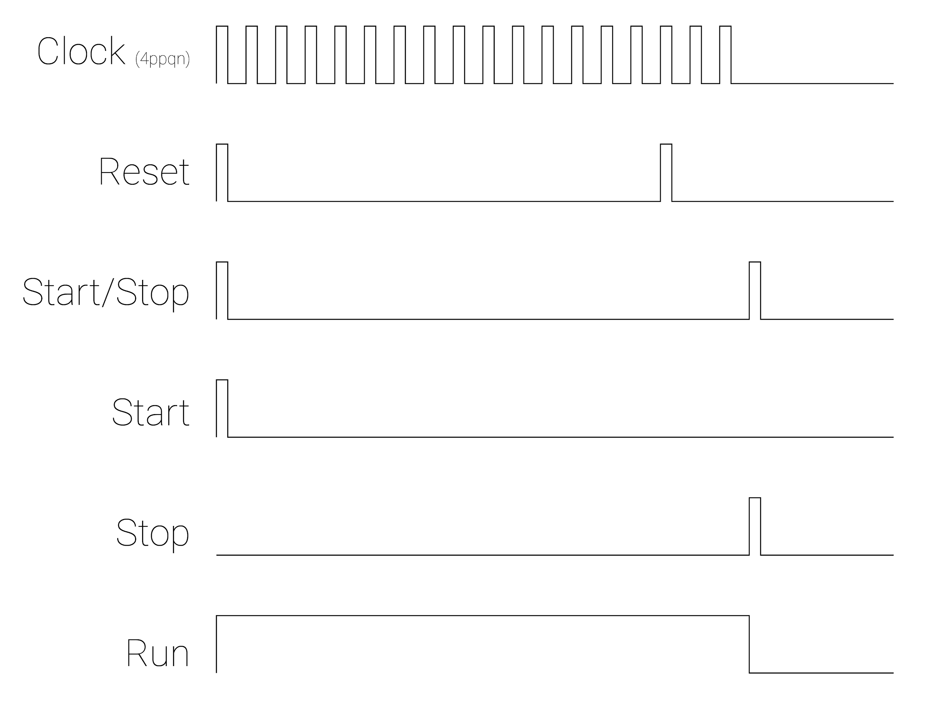
Hardware Interfacing: Clock Sync
MIDI-to-CV: Computer or Other synthesizer as leader, modular as follower
CV-to-MIDI: Modular as Leader, Other Gear Follows
DC-coupled Interfaces: allow either device (computer or modular) to be leader/follower
Start/Stop: A trigger which indicates the clock should begin/stop.
Run: A gate which indicates the clock should be running.
Reset: A trigger which indicates the start of the bar
Clock: A repetitive pulse which drives other devices.

Slide 22
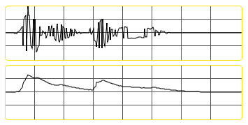
Envelope Followers
Envelope Followers extract a "volume envelope" from an audio signal, i.e. a voltage contour which rises as the input audio signal gets louder and falls as the output audio signal decreases.
Sending an external audio source into an envelope follower can be an interesting strategy for using the intensity of one audio source, like the human voice, to control the parameters of a synthesis chain.
Instead of using an envelope generator to control the loudness of another sound, the loudness of a sound creates the envelope!

Slide 23
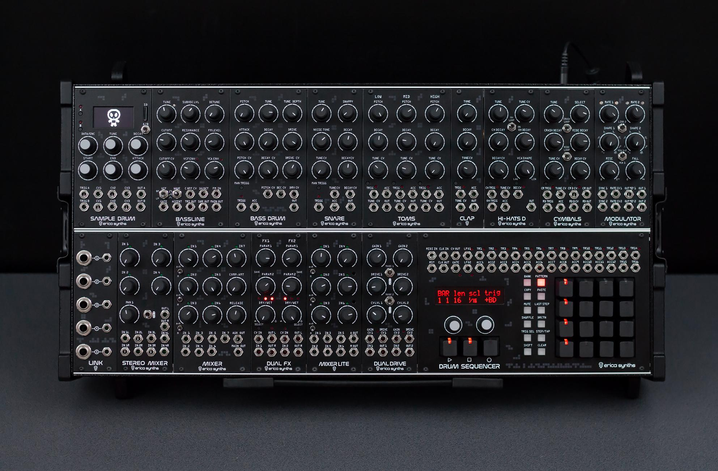
Sonic Goals and Planning
Erica Synths Techno System
Styles:
FX/Audio Processing
Live Sampling/Field Recording
Groovebox/Techno
Ambient/Generative
Axes to Consider:
Performance vs. Recording
Improvised vs. Planned
Generative vs. Composed
Questions:
What will my sound sources be?
How will I control, create or discover events, rhythm, pitch, and timbre?
How will I process, sculpt, and evolve control voltage and sound?

Slide 24
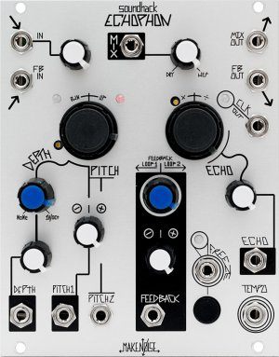
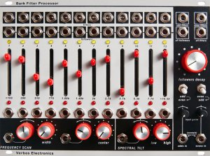
External Audio Processor/FX
Make Noise Echophon, Verbos Bank Filter Processor, Intellijel Audio I/O
I/O: Preamp, Output module
FX Modules: Flexible multi-FX modules vs dedicated FX
Envelope Follower: Dedicated, or Rectifier+Slew Limiter
Filters: Spectral/EQ, Physical Modeling Resonators, LP/BP/HP
Mixers: Matrix Mixers? Performance Mixers? Combo VCA/Mixers
Modulation and VCAs!

Slide 25
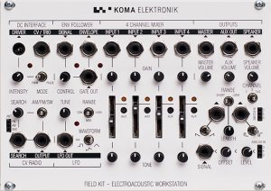
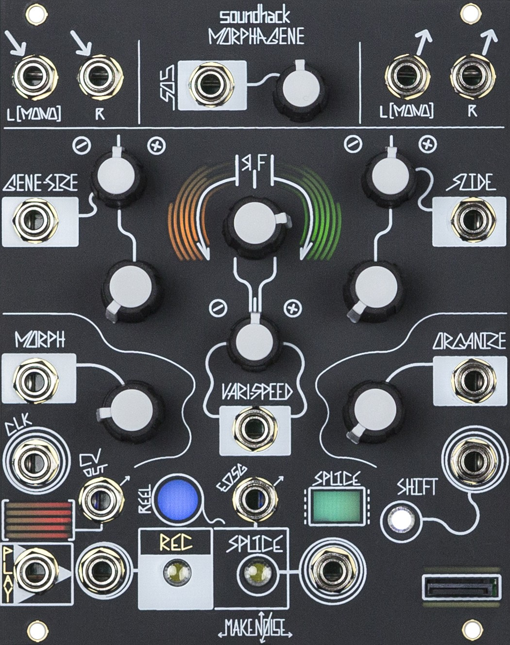
Live Sampling, Field Recording, concrète
I/O: Preamp, Output module
Sampling: SD File playback vs live recording buffers
FX+Signal Processing: How will you transform your sound?
Clock+Sequencing: How will you trigger playback?
Filters, Modulation, Mixers, and VCAs!
KOMA Elektronic Field Kit, Make Noise Morphagene

Slide 26
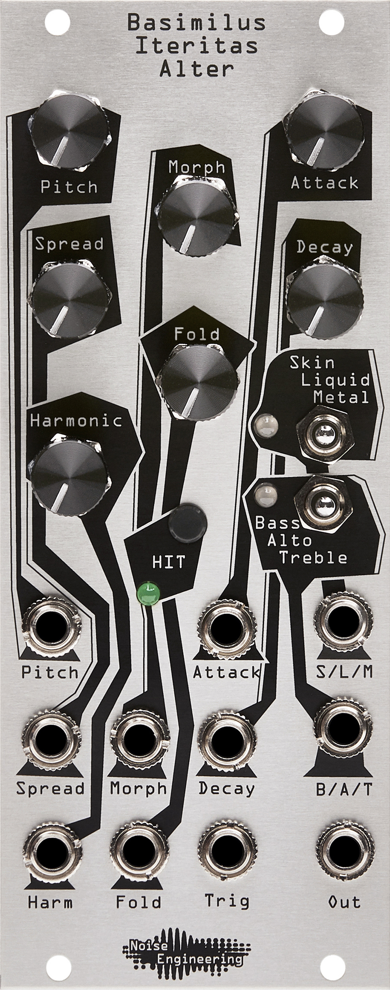
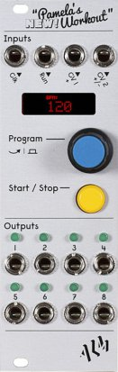
Groovebox/
Techno
Noise Engineering Basimilus Iteritas Alter, ALM Pamela’s New Workout
Sequencer: Internal/External? Grid/Evolving? Trigs/Gates/CV?
Modulation: How will you create rhythm and events?
Sound Source: Full voice modules, percussion modules, VCOs
Sampling: Triggerable SD file playback
Filters, Modulation, Mixers, and VCAs!

Slide 27
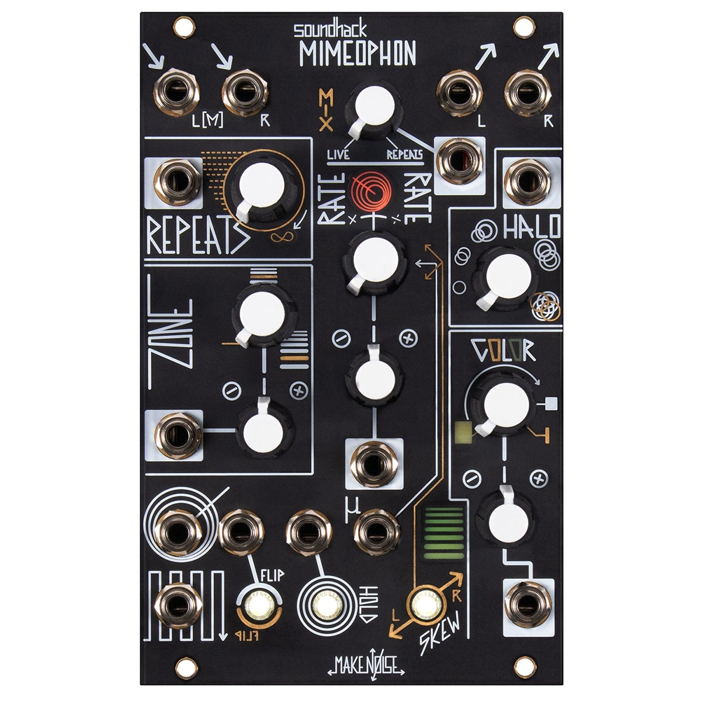
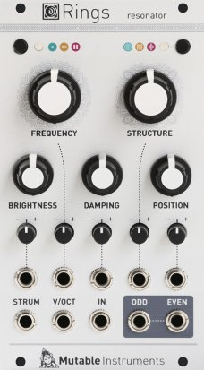
Ambient/
Generative
Pitch: Sequencer/Pattern Generators/S+H + Quantizer or Drone
Sound Source: VCOs, Physical Modeling, SD Playback Percussion
Filters: Spectral/EQ, Resonators, LP/BP/HP
FX/Audio Processing: Wavefolding, Multi-FX, dedicated FX?
Modulation: How will you sculpt and evolve your sound?
Mixers and VCAs
Make Noise Mimeophon,, Mutable Instruments Rings
Pitch: Sequencer/Pattern Generators/S+H + Quantizer or Drone
Sound Source: VCOs, Physical Modeling, SD Playback Percussion
Filters: Spectral/EQ, Resonators, LP/BP/HP
FX/Audio Processing: Wavefolding, Multi-FX, dedicated FX?
Modulation: How will you sculpt and evolve your sound?
Mixers and VCAs

Slide 28
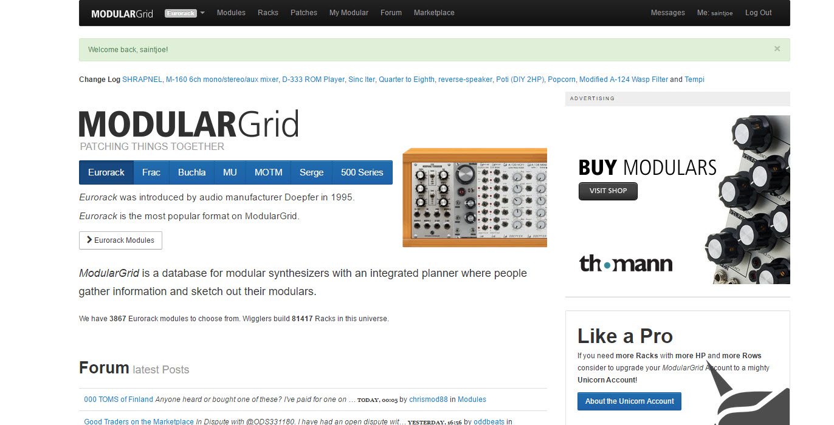
ModularGrid
ModularGrid is a community driven database for modular synthesizers that features a drag and drop case planner, a forum, and marketplace.
Look up modules by manufacturer, primary and secondary functions, width, depth, and popularity!

Slide 29
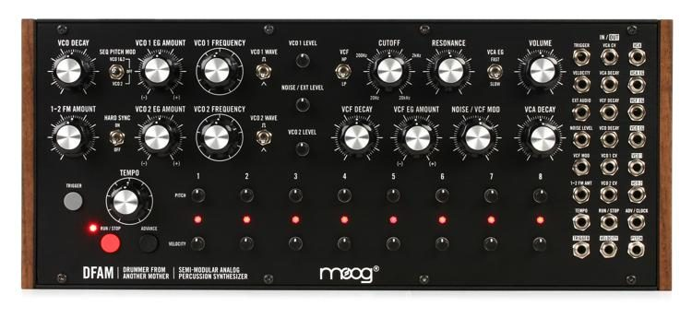
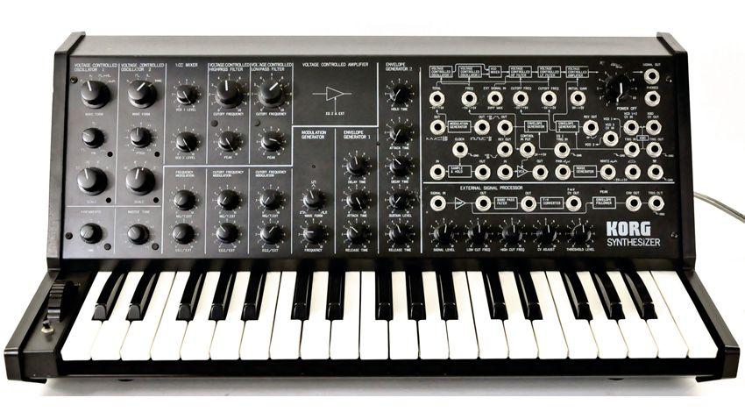
Semi-Modulars
https://media.sweetwater.com/api/i/q-82__ha-422c8cf6c045306c__hmac-1df2baf6e9ede3c6d387e65bfd3eb734a8919217/images/items/750/DFAM-large.jpg
A Semi-Modular sits halfway between conventional, fully pre-patched synthesizers and modular synthesizers.
Fundamentally, it is a self-contained voice with a number of prewired or normalled modules. It is a standalone instrument but allows users the ability to expand its capability via a patchbay that allows for additional connectivity as well as introducing or rerouting signals in the system.

Slide 30
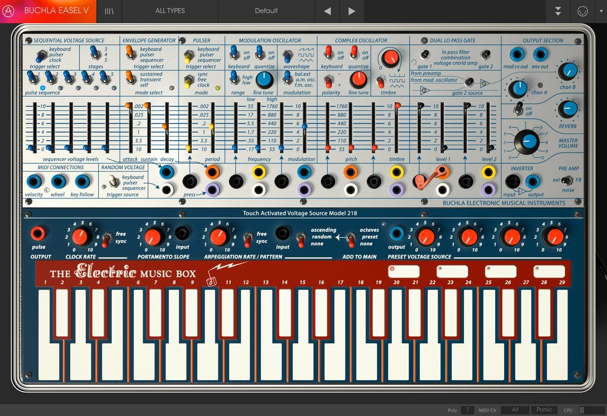
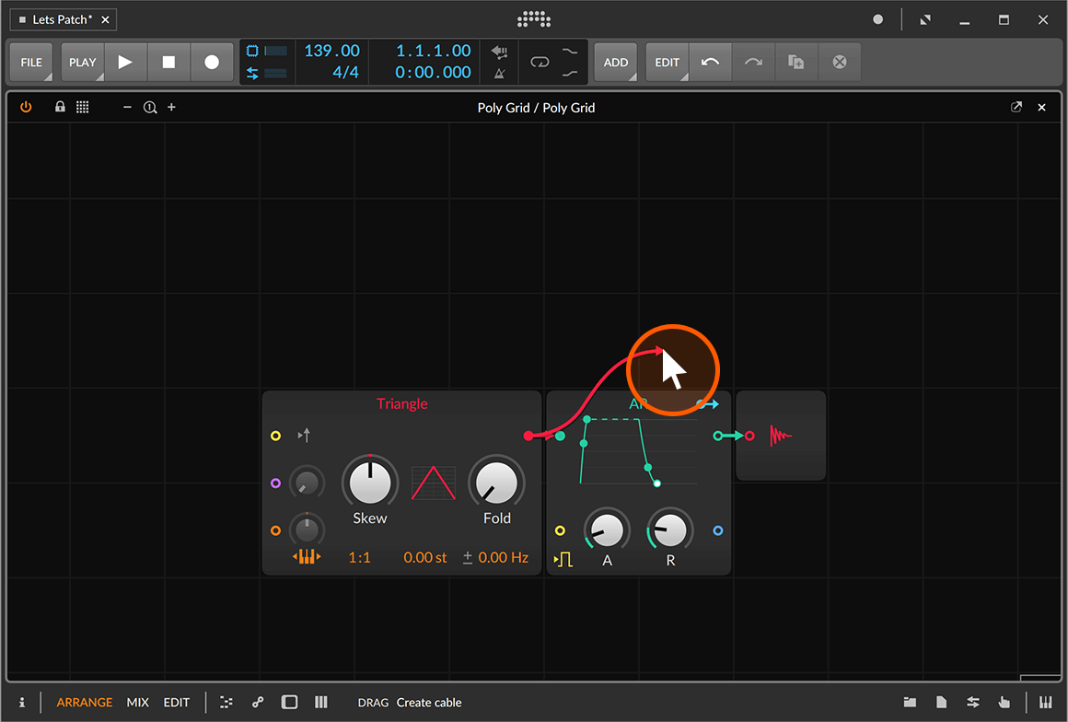
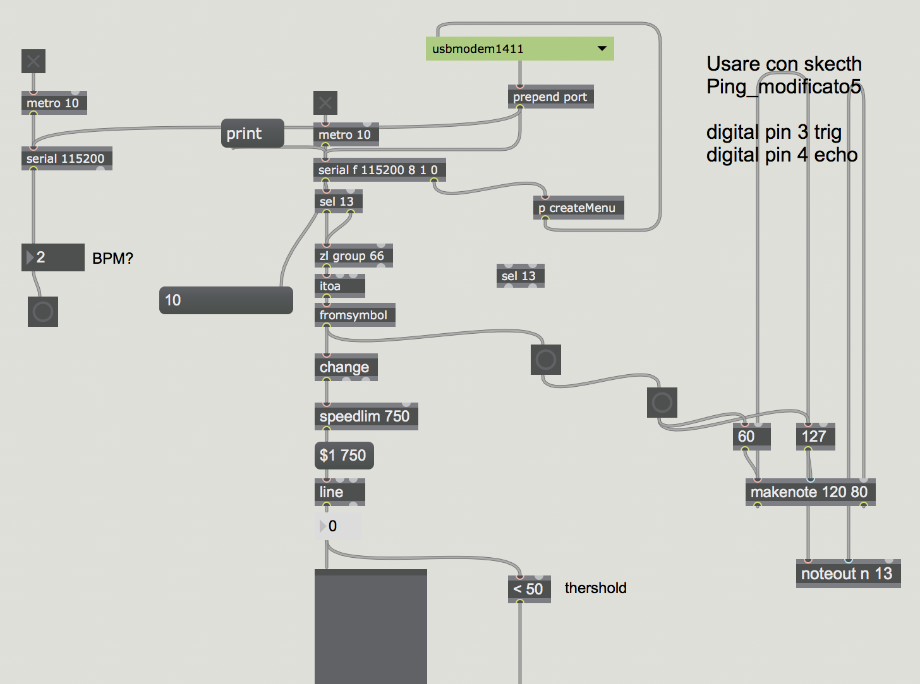
Digital Modular
Max/MSP
BitWig’s Grid
Reaktor
VCV Reaktor
Arturia Modular

Slide 31
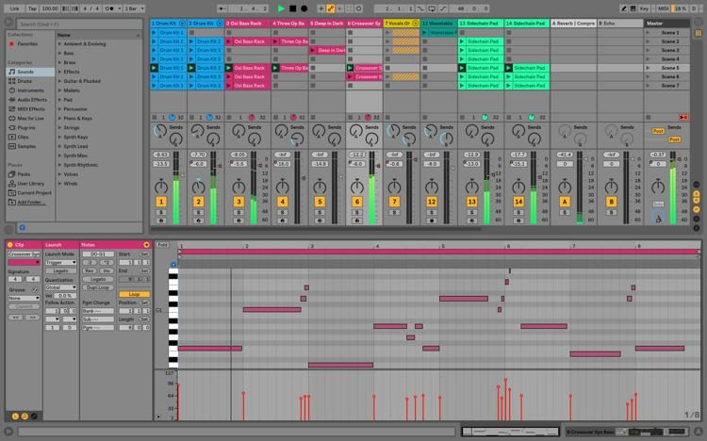
DAWs
A DAW or digital audio workstation is software (less often hardware) for recording, mixing, editing and processing audio files. Most DAWs also incorporate MIDI functionality, allowing notes to be programmed or played via MIDI controller to play virtual instruments.
Free
Garageband
Audacity
Ableton Live Lite
Paid
Ableton Live 10
BitWig

